Slide 1
System Identification within Flight Test and Flight Physics
02.03.2018
A project proposal
Alejandro Valverde
Notes:
Hello everyone, my name is Alejandro Valverde and I have an idea. Idea which I would like to propose to you today.
What I am going to introduce now is not entirely the result of my own work, but it incorporate valuable feedback that I have receive from different people in this company over the last few days.
For those of you already initiated in this topic, I would like to implement System ID techniques into the current Flight Testing methodology. I would do this in a:
Cost effective,
Efficient, and
Accurate,
ways. And in this presentation, I will describe how I want to do this.
Now, for those of you not initiated in this topic…

Slide 2
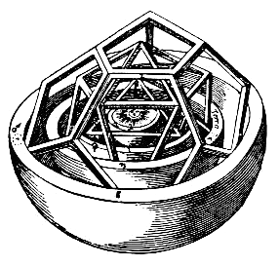
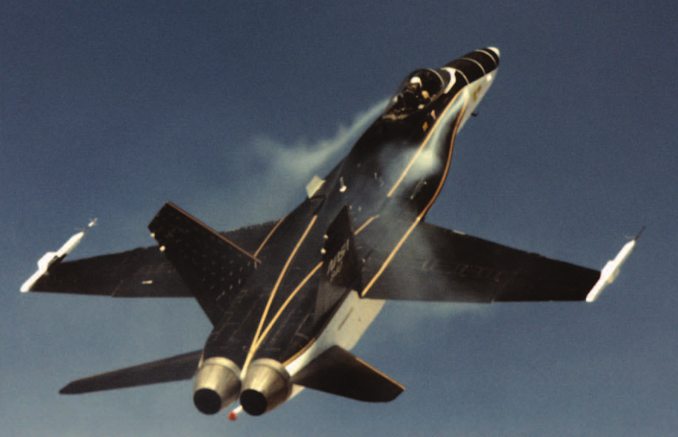
Aircraft System Identification
System Identification is the process of building mathematical models for physical systems based on imperfect observations or measurements
When applied to aircraft, it is called Aircraft System Identification
@ Kopter Group AG | Alejandro Valverde
Notes:
One of the oldest and most fundamental of all human scientific pursuits is developing mathematical models for physical systems based on imperfect observations or measurements. This activity is known as system identification. When applied to aircraft, this is known as aircraft system identification.
And this is in fact one of the reasons why I am so interested in this topic, This discipline is fairly unknown in the aerospace industry, but it is in fact something that scientists and engineers have been doing for hundreds of years.
I like to recall know the contribution to human progress made by Johannes Kepler when, in 1609, he published the book Astronomia nova which presented a mathematical model that describe the motion of the planets in the Solar System. For this, he collaborated with the Swedish Tycho Brahe, who provided him with precise data of planets position in the sky. This was System Identification.

Slide 3
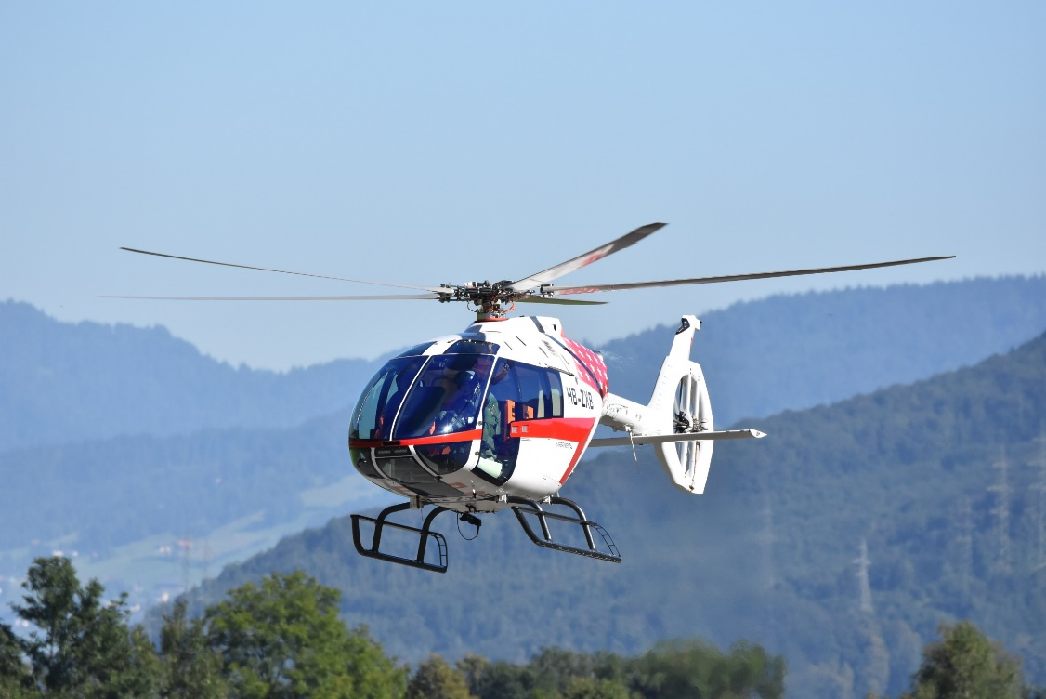
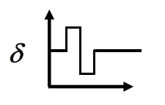
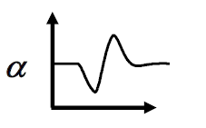
Problems in Aircraft Dynamics
Input, u
Output, z
System, S
Simulation: Given u and S, find z
Control: Given z and S, find u
Identification: Given z and u, find S
@ Kopter Group AG | Alejandro Valverde
Notes:
Now, in our company, we have already covered some of the classical problems of Aircraft Dynamics.
Simulation: This is what the guys from Flight Physics do when they use FlightLab
Control: This is what our pilot does in his brain.. Since, we don’t have yet developed an autopilot, we don’t need to worry too much about this point.
Identification: Here is when we obtain a model for our helicopter, considering both the input and output to the model.
For Kepler, this box was occupied by the solar system, for us this is the SH09; but in fact it same. Well, in fact, poor Kepler’s task was harder than ours because he did have control over the inputs to the system and we do have.

Slide 4
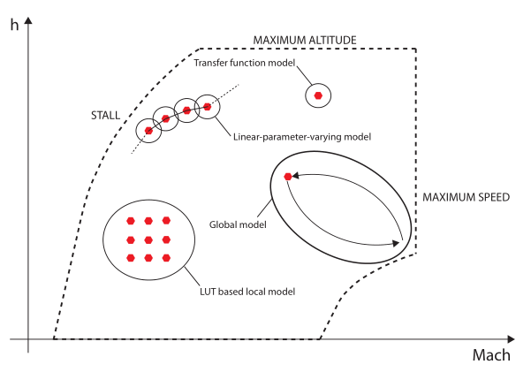
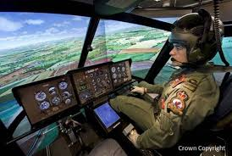
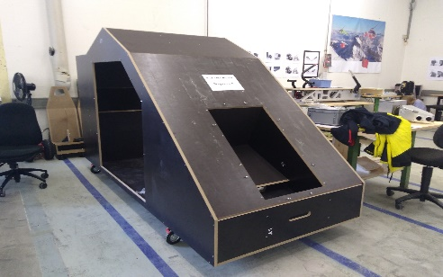
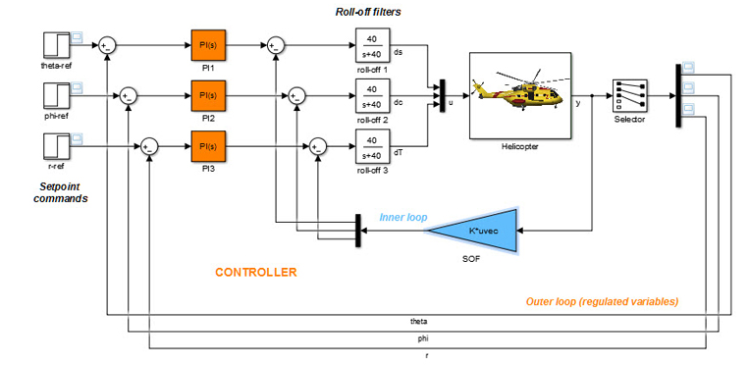
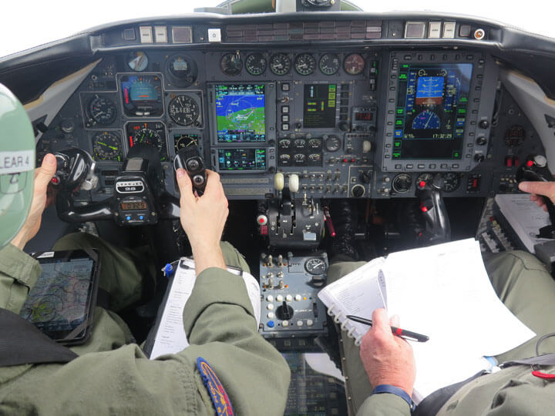
Applications of Aircraft System ID techniques
Aircraft System Identification offers a wide range of different applications, including:
Flight Simulator development
Flight envelope expansion
Flight Control System (FCS) design
Handling Qualities assessment
and enhancement
@ Kopter Group AG | Alejandro Valverde
And many others…
Notes:
Flight Simulator development: When we require an accurate representation of the aircraft in all the flight conditions. Many aircraft motions and flight conditions simply cannot be duplicated in the wind tunnel nor computed analytically with sufficient accuracy or computational efficiency
Flight Envelope Expansion: Quantifying stability and control impact of aircraft modifications, configuration changes, or special flight conditions;
Flight Control Systems Stability augmentation and flight control systems. This is essential requirement for certain flight conditions such as night flying and others low-visibility conditions (acc. to Michael, Kopter Flight Test pilot). (It is needed to consider the models limitations and the type of aerodynamic effects.)

Slide 5
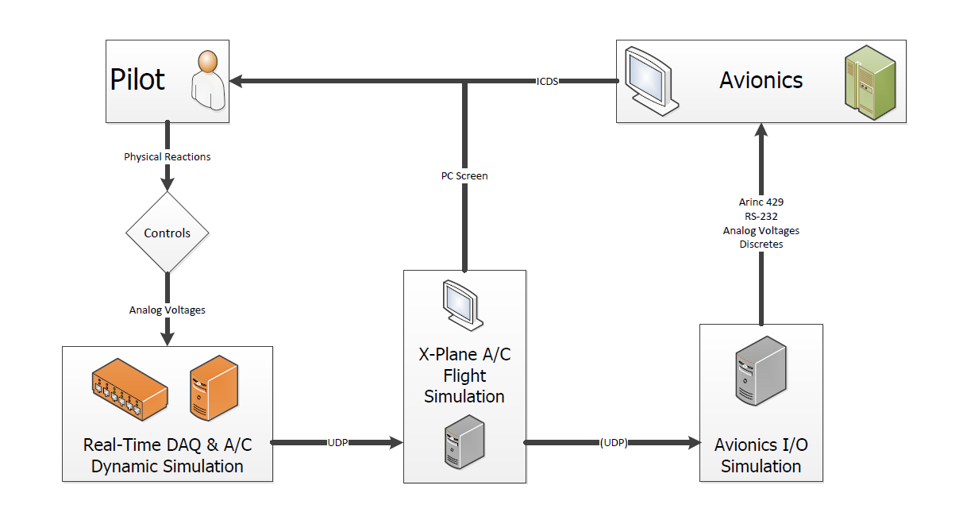
Aircraft Simulation - Ongoing Kopter project
Extracted from Nicolas Callejo’s MSc Thesis overview in collaboration with Kopter Avionics Dep.
@ Kopter Group AG | Alejandro Valverde

Slide 6
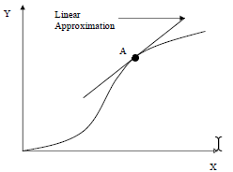
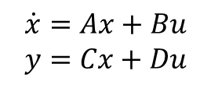
Aircraft Simulation – Current Kopter approach
Dynamic Simulation
Trimmed condition of FlightLab, e.g.:
Non-linear model
fwd level flight @ 100kts
Linear model
linearization of full H/C dynamics in LTI model:
Suitable for:
$$\dot{x}=Ax+Bu$$
$$y=Cx+Du$$
FCS design
H/C flight simulation
Aircraft dynamic stability analysis
@ Kopter Group AG | Alejandro Valverde

Slide 7
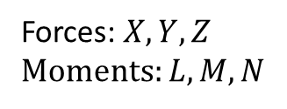
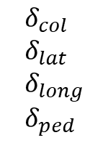
Aircraft Simulation – Aircraft SID approach
Dynamic Simulation
$$δ_{col} \\ δ_{lat} \\ δ_{long} \\ δ_{ped}$$
Non-linear model
Pilot inputs
Aerodynamic, structural and propulsive H/C model
Equations of Motion
Forces: $X,Y,Z$ Moments: $L,M,N$
In the form of
System ID provides an accurate, simple and reliable
model of the H/C dynamics obtained from real flight test data of the real H/C
LUTs
LPV model
…
@ Kopter Group AG | Alejandro Valverde
Notes:
Accurate -> Because it’s based on real flight data
Simple -> Does not require high computational power
Reliable -> Computed with

Slide 8
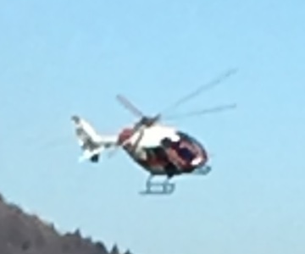
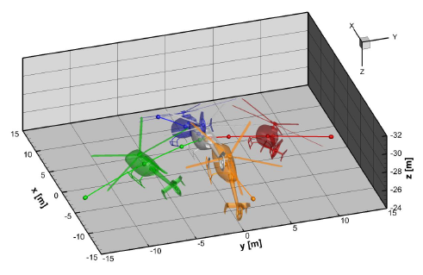
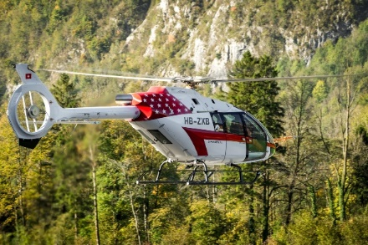
System ID R/C Model vs FlightLab
H/C model from System ID
FlightLab H/C model
Advantages:
High accuracy provided that good quality data points are available
Validation -> instantaneous
Non-linear flight dynamics
Transient flight conditions
Real-time dynamic modelling
Account for aeroelastic effects
Drawbacks:
Depend on flight test data availability and dedicated flight manoeuvres
Advantages:
Not dependent on flight test data
Model complexity adjustable: Full aeroelastic -> loads&dynamics Rigid -> flight mechanics
Drawbacks:
Validation -> complicated
Full aeroelastic model -> complicated
Internal parameters hard to properly be tuned
Best use: Prediction of H/C:
- H/C and compnt. loads
- Rotor dynamics
- H/C Performance
Best use: Dynamic model of the real H/C: - FCS design - Handling qualities - Simulator development
@ Kopter Group AG | Alejandro Valverde
Notes:
Flightlab can be used also for evaluate helicopter design changes impact or for the preliminary design of a new vehicle,
identified model cannot be used to infer anything about a vehicle different from which was tested and identified.

Slide 9
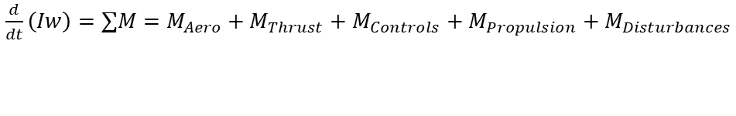
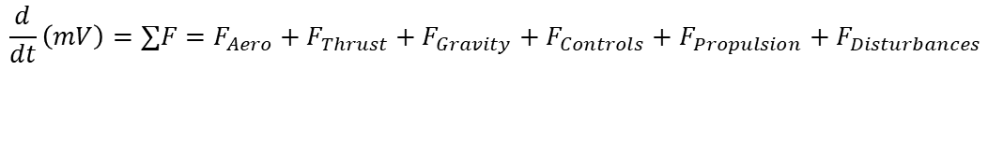
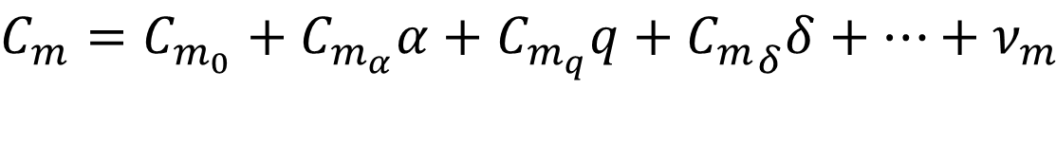
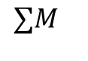
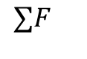
How does it work?
$$\frac{d}{dt}\left(mV\right)=∑F=F_{Aero}+F_{Thrust}+F_{Gravity}+F_{Controls}+F_{Propulsion}+F_{Disturbances}$$
Forces and moments
$\frac{d}{dt}\left(Iw\right)=∑M=M_{Aero}+M_{Thrust}+$ $M_{Controls}+M_{Propulsion}+M_{Disturbances}$
$$∑F$$
Develop a model form from which parameters can be estimated using flight test data
$$∑M$$
for example
Pitching moment coefficient
longitudinal angular velocity
pitch control input
H/C angle of attack
measurement noise
$$C_{m}=C_{m_{0}}+C_{m_{α}}α+C_{m_{q}}q+{C_{m}}_{δ}δ+…+ν_{m}$$
pitching moment bias
static stability
dynamic stability (damping)
pitch control authority
@ Kopter Group AG | Alejandro Valverde

Slide 10

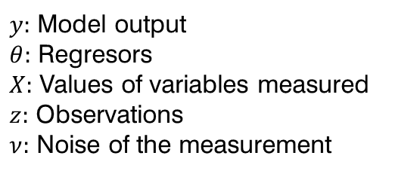

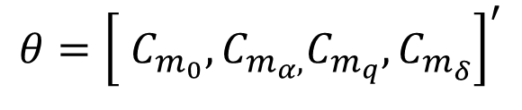
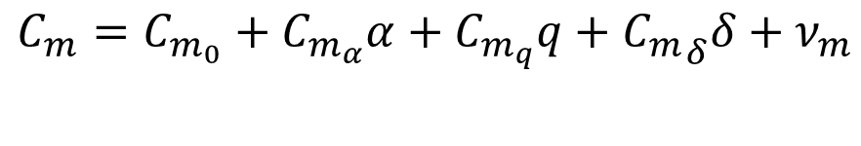
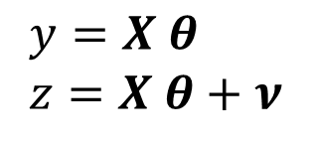
How does it work?
Pitching moment model:
$y:$ Model output
$θ:$ Regresors
$X:$ Values of variables measured
$z:$ Observations
$ν:$ Noise of the measurement
$$C_{m}=C_{m_{0}}+C_{m_{α}}α+C_{m_{q}}q+{C_{m}}_{δ}δ+ν_{m}$$
$$θ={\left[ C_{m_{0}},C_{m_{α},}C_{m_{q}},C_{m_{δ}}\right]}^{′}$$
Vector of regressors (parameters to be identified)
Observations$z$
SID Model:
- Simple
- Real time parameters estimations
$$y=X θ \\ z=X θ+ν$$
Equation-Error
Solved in one-shot linear algebra
two approaches
Solved with iterative nonlinear optimization
- Any nonlinear system dynamics
- Machine learning techniques
$$\hat{θ}$$
Output-Error
@ Kopter Group AG | Alejandro Valverde
Notes:
NOTES
The coefficients of the Taylor series expansion are the aero-dynamic model parameters to be estimated. These parameters are therefore a function of flight condition for the test.

Slide 11
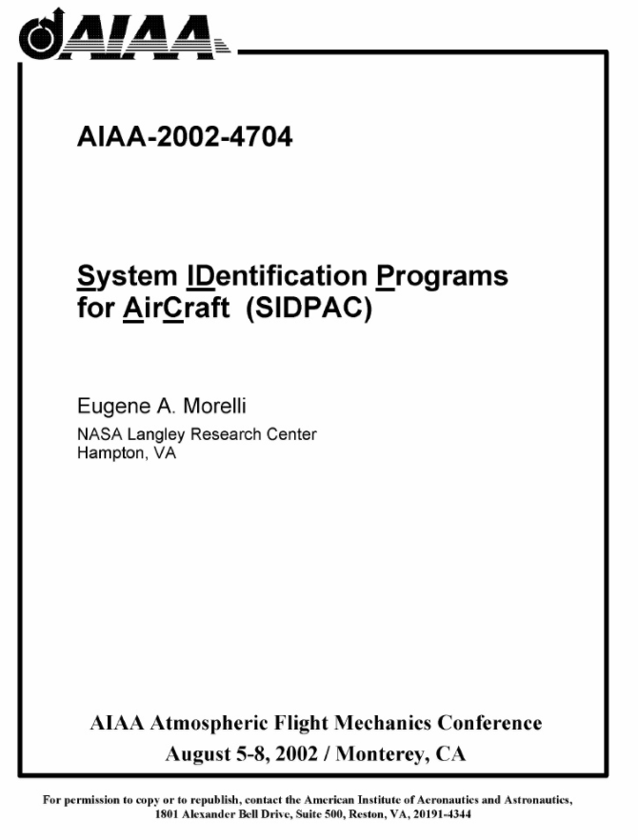
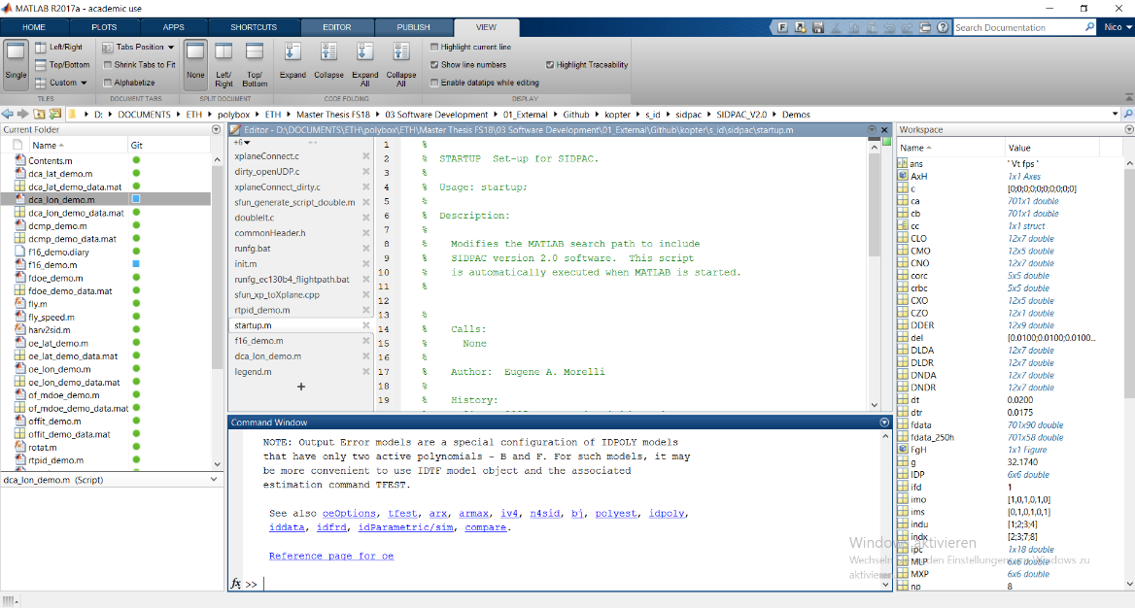
Tools – SIDPAC software
Implemented in Matlab
Collection of over 350 state-of-the-art programs
Used at more than 80 organization worldwide
No development time needed
@ Kopter Group AG | Alejandro Valverde

Slide 12
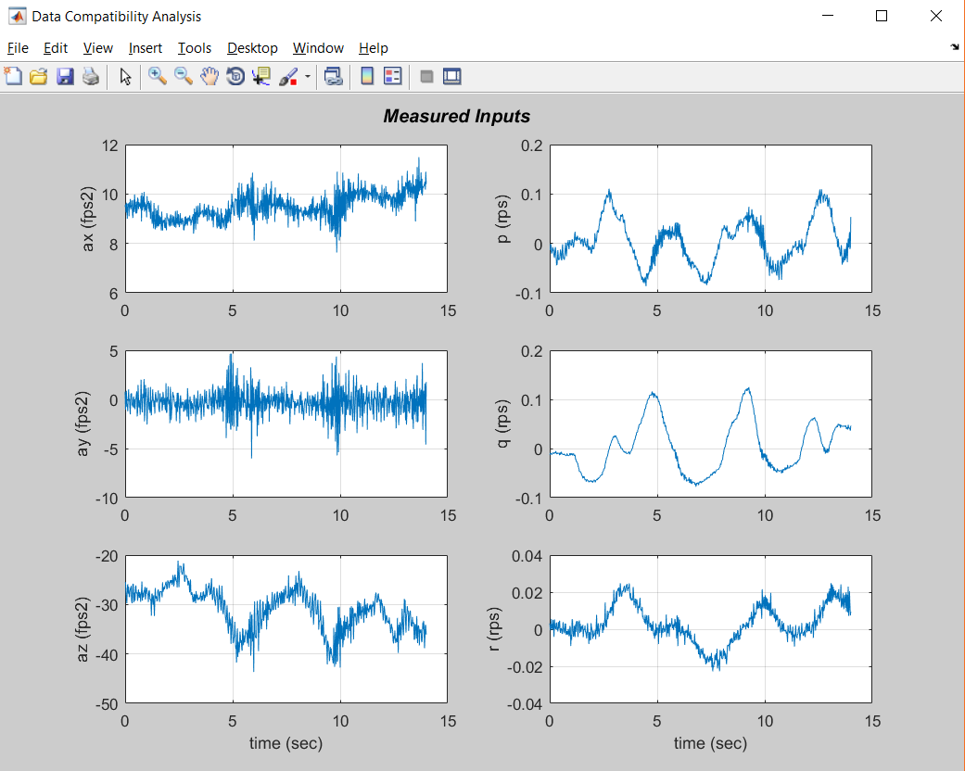
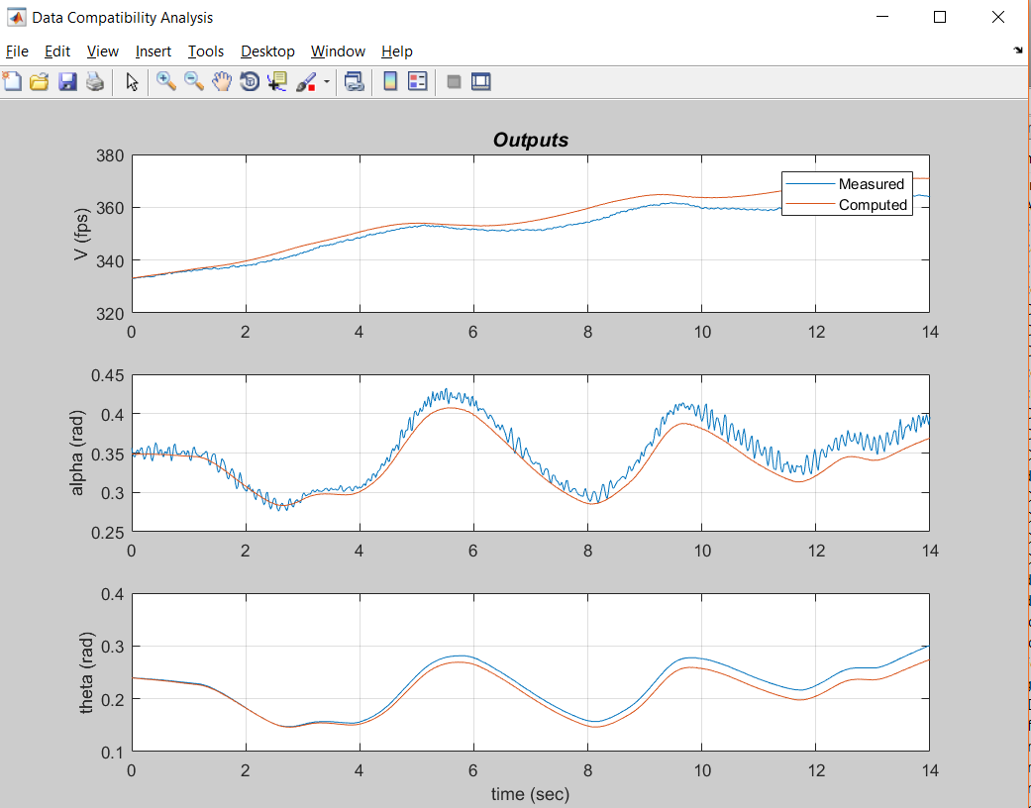
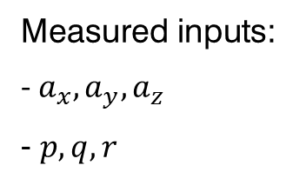
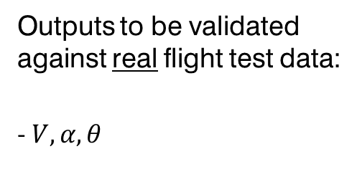
Tools – SIDPAC software
SID H/C Model
Measured inputs:
- $a_{x}, a_{y}, a_{z}$ - $p, q, r$
Outputs to be validated against real flight test data:
- $V, α, θ$

Slide 13
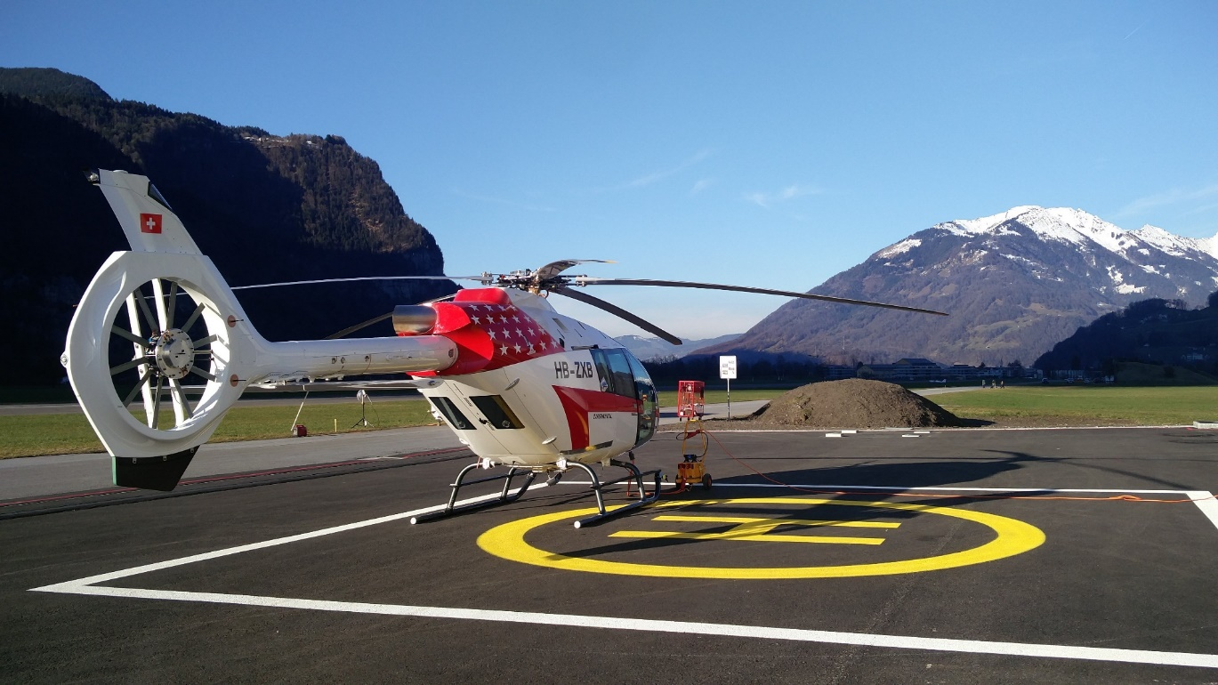


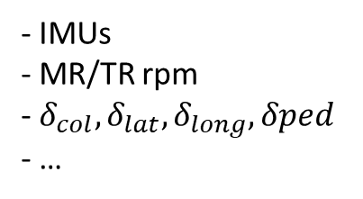
What would we need?
Complete instrumented helicopter
- IMUs
- MR/TR rpm
- $δ_{col}, δ_{lat}, δ_{long}, δped$
- …
We already have this
A laptop
Some coffee…
@ Kopter Group AG | Alejandro Valverde

Slide 14

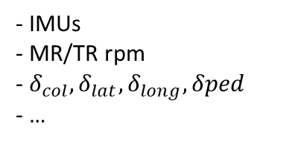
What would we need?
Flight Physics
SID framework development
Complete instrumented helicopter
- IMUs
- MR/TR rpm
- $δ_{col}, δ_{lat}, δ_{long}, δped$
- …
We already have this
Flight Test operations
Dedicated flight test points
Some of those they may already be within the current Flight Test Program
Data to be provided by Flight Test Data Analysis Team
Little involvement needed as data in raw form is analysed for SID methods
@ Kopter Group AG | Alejandro Valverde
Notes:
According to Lemke:
Do not underestimate resources
Having one person full dedicated to this project
Requirements to Flight Test Data analysts
Maybe I don’t require a lot from them. I would need to work directly from the raw data, unfiltered
Data portioning can be easily done as pre-processing prior the SID parameter estimation
Filtering should not be done analogy, as in most of the cases, no a priori knowledge of the frequency band of interest
It is preferred to use post-flight data smothering techniques such as
Frequency-Domain Filter Implemented in the Time Domain
Local Smoothing in the Time Domain
Global Smoothing in the Frequency Domain

Slide 15
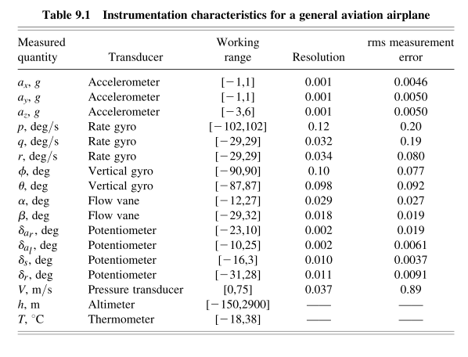
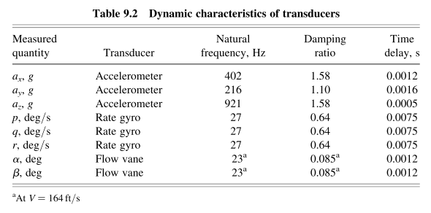
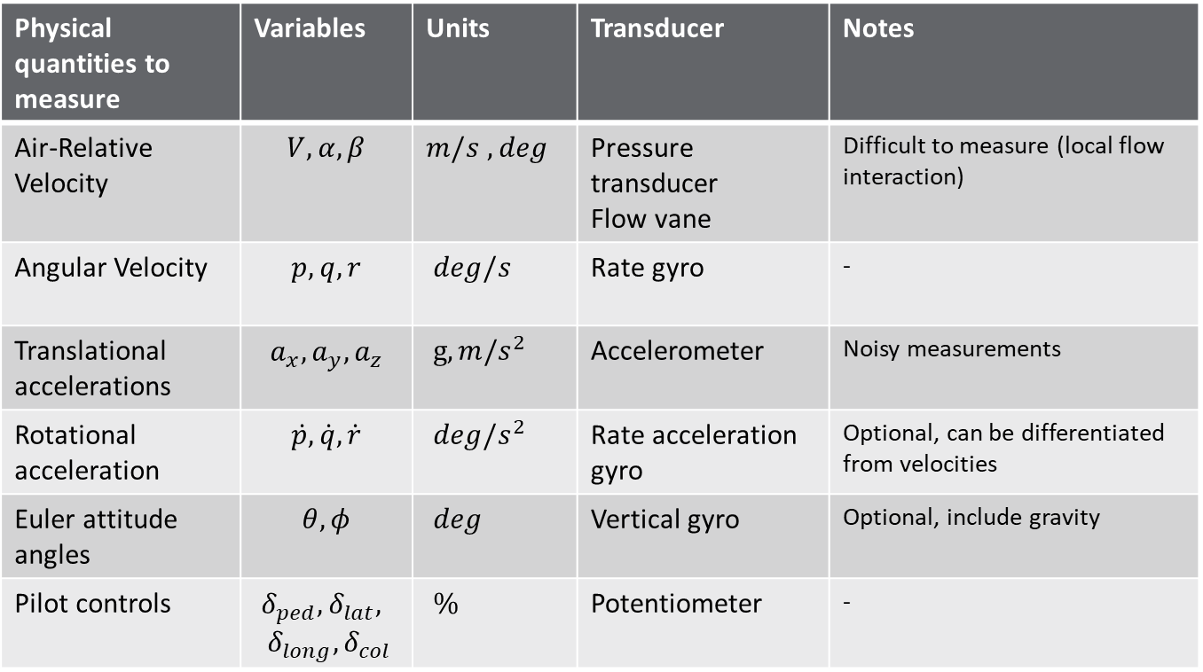
Instrumentation overview
Physical quantities to measure | Variables | Units | Transducer | Notes
Air-Relative Velocity | $$V, α, β$$ | $m/s$ $, deg$ | Pressure transducer Flow vane | Difficult to measure (local flow interaction)
Angular Velocity | $$p, q, r$$ | $deg/s$ | Rate gyro | -
Translational accelerations | $$a_{x}, a_{y}, a_{z}$$ | $g, m/s^{2}$ | Accelerometer | Noisy measurements
Rotational acceleration | $$\dot{p}, \dot{q}, \dot{r}$$ | $deg/s^{2}$ | Rate acceleration gyro | Optional, can be differentiated from velocities
Euler attitude angles | $$θ, φ$$ | $deg$ | Vertical gyro | Optional, include gravity
Pilot controls | $$δ_{ped}, δ_{lat}, \\ δ_{long}, δ_{col}$$ | $\%$ | Potentiometer | -
Notes:
Air-Relative Velocity
It doesn’t matter where this sensors are placed in the helicopter. There always be corrections to be made.

Slide 16
Inputs
Constraints on inputs:
Rate of data acquisition
Limited resolution on sensors or data acquisition system
Limited time for each maneuver
Limitations on how the aircraft can be excited
Notes:
Manoeuvre definition:
Manoeuvre time length,
Control surfaces or pilot inputs to be moved,
Input forms (e.g., square wave, frequency sweep, etc.), which includes the input amplitudes.

Slide 17
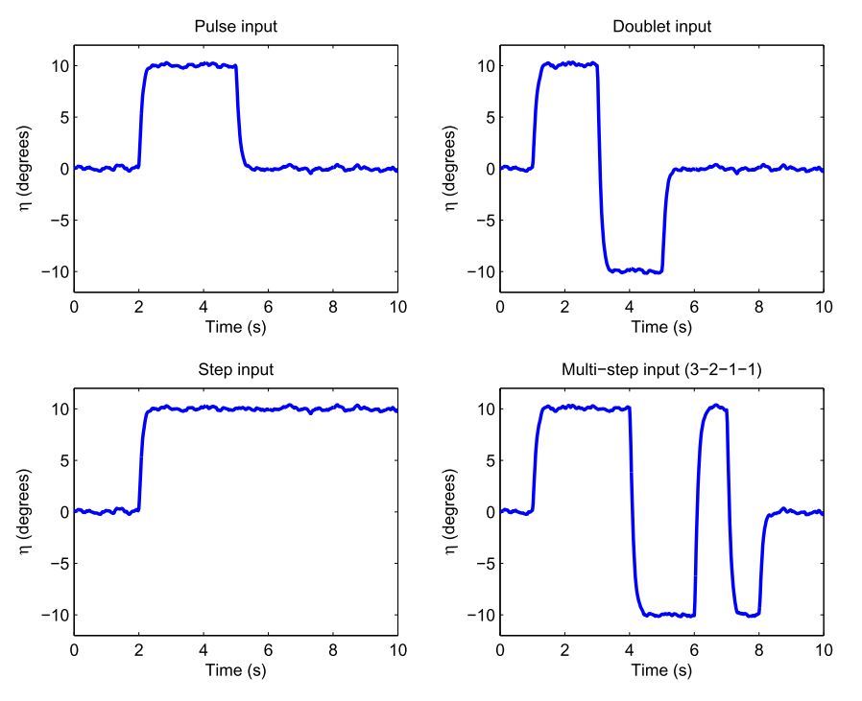
Inputs
Notes:
-> Two runs with the same inputs for data analysis

Slide 18
Why to introduce System ID into P3 test campaign?
Sooner or later, it would need to be implemented
Every big helicopter manufacturer has a dedicated SID department
SID framework could be developed now using P2 flight test data
Assist P3 flight envelope expansion in Sicily, necessary for TC. Issues like the cyclic migration could be addressed and main driving parameters identified.
We have to do it now,
we are ready now
Provide a proper dynamic model of the H/C
for the simulator
Surely it will be needed for PS4 and further
developments after TC, such as FCS design
Cost effective
System ID takes time and money – but not nearly as much as not doing it Eugene A. Morelli NASA Langley Research Center Hampton
@ Kopter Group AG | Alejandro Valverde
Notes:
Cyclic migration.. Identify driving parameters of this behavior and properly address it.
In my vision, P3 flights (some fractions of) could be used to collect data for SID, and in the meantime the tool can be developed. Providing a robust and reliable software for this scope is not a simple thing and requires a lot of time!

Slide 19


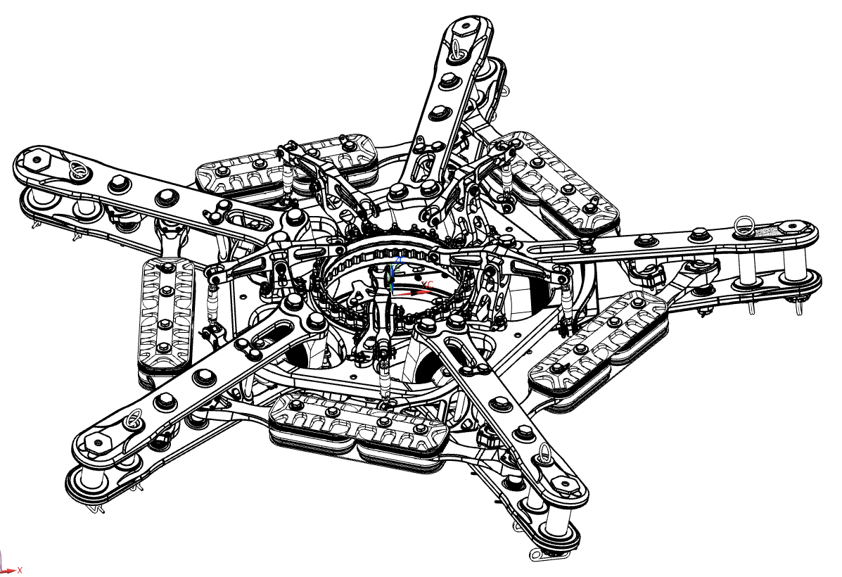
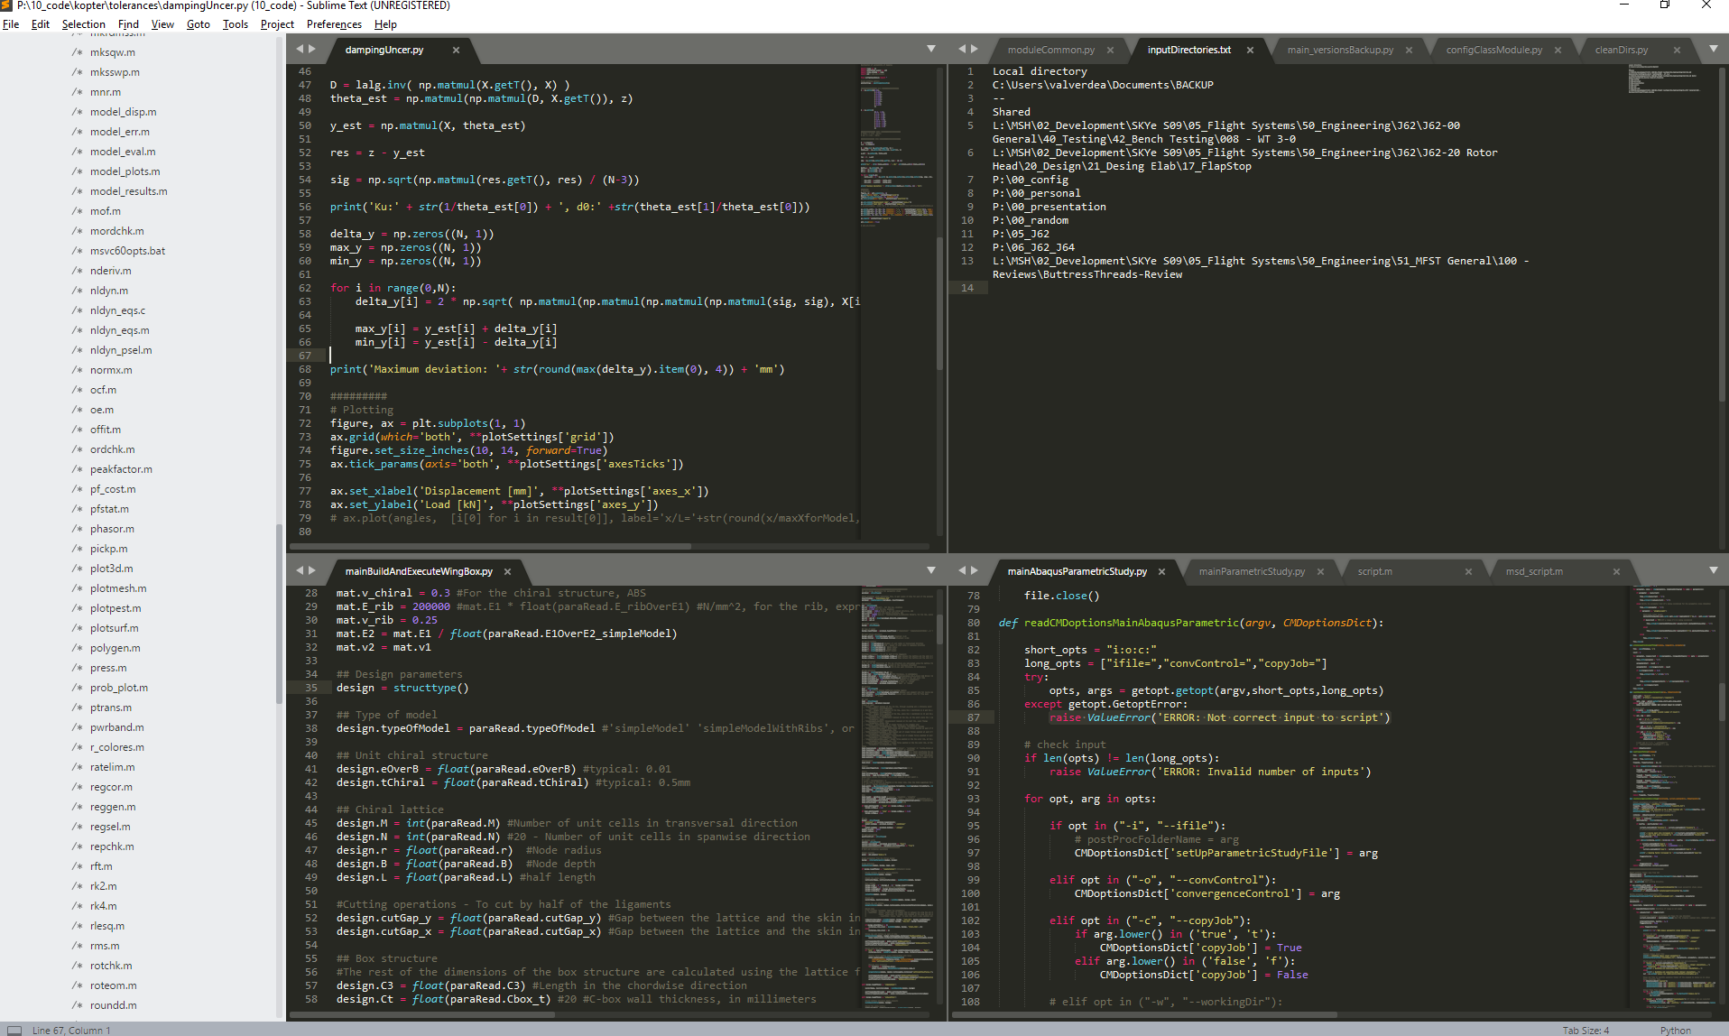
Why I can be the one doing this?
Young
Passionate
I know what to do and how to do it
Kopter experience, within rotorheads
Data analysis experience
Python
Matlab
Data analysis and machine learning techniques
…
Availability from April onwards
@ Kopter Group AG | Alejandro Valverde

Slide 20
Next steps – Near future
Perform first approach System ID on FlightLab:
Rigid body System ID framework
FlightLab linearized model
Inclusion of simulated disturbances in the measurements
April
Develop a System ID framework suitable for real flight test data:
Rigid body System ID framework
Use of P2 flight test data if suitable
Assessment of handling qualities issues
Inclusion of aeroelastic effects
Provide dynamic model of P2 suitable for:
FCS design
Simulator development
Beginning of summer
Assist P3 flight envelope expansion in Sicily:
Developed System ID framework could be ready to:
Perform post-flight analysis for accurate parameter estimation
Real-time dynamic modelling
Address handling qualities issues
Beginning of summer
…
@ Kopter Group AG | Alejandro Valverde
Notes:
First phase:
We can start approaching the problem using the simplest available model in Flightlab (MR and TR rigid, fuselage rigid) and generate linearized model at different trim flight condition and W/CG configuration, to be used for identification.
Second phase:
We can integrate the identification routine with Flightlab (it implies non-trivial software engineering effort in order to call Flightlab runs from Matlab) working directly in the non-linear environment, optimizing directly some parameters of the Flightlab model to match the flight data.

Slide 21
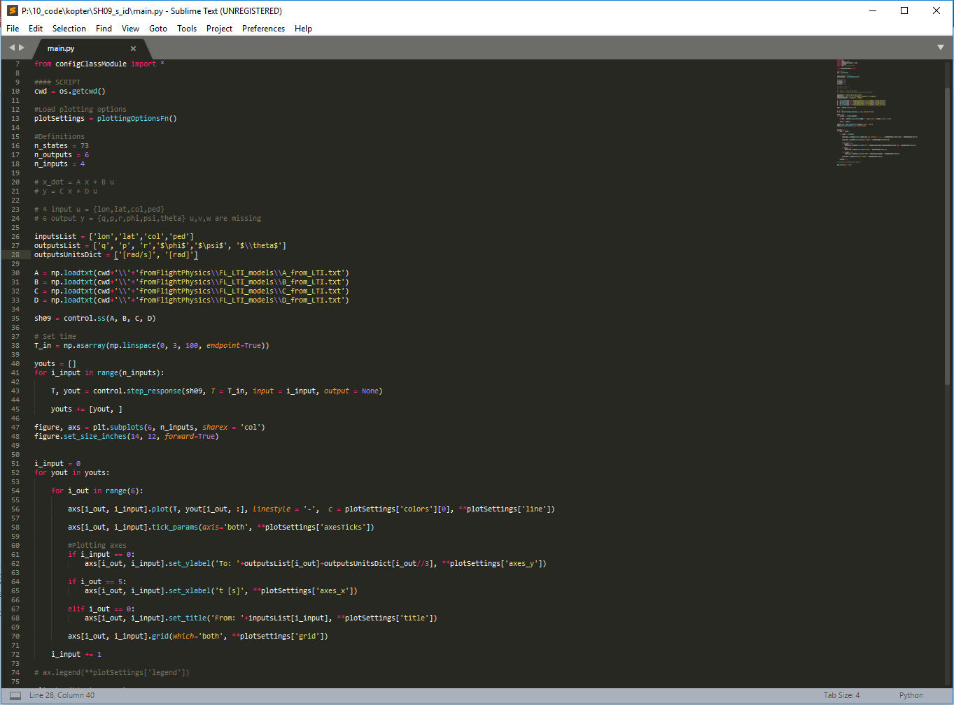
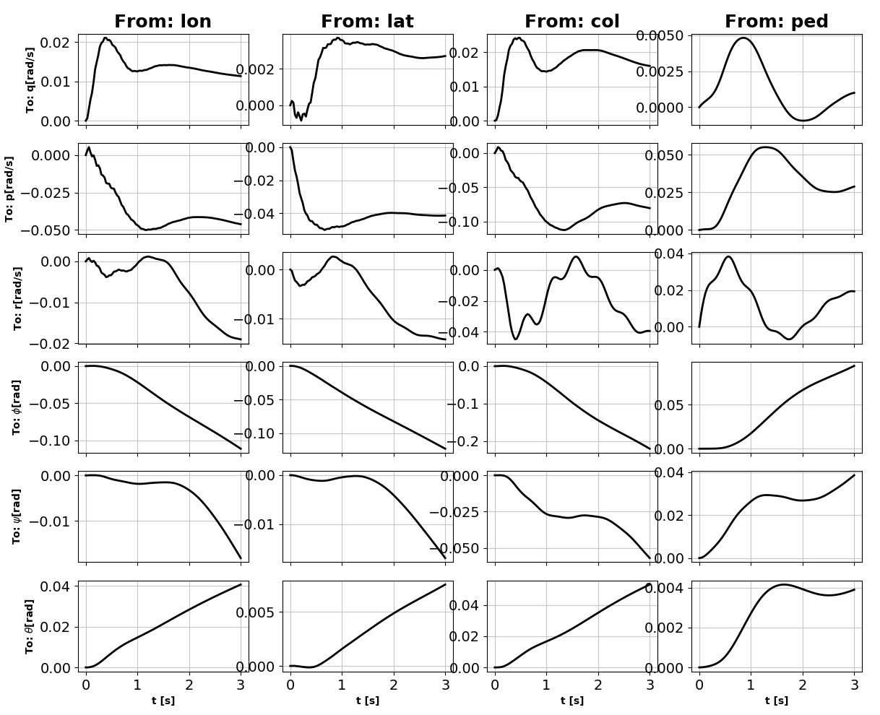
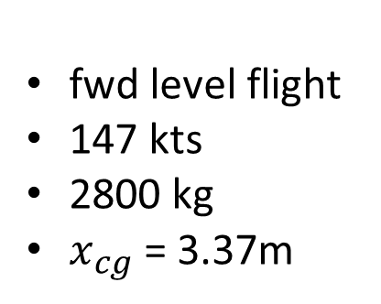
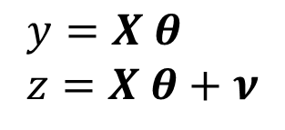
First steps, using FlightLab
fwd level flight
147 kts
2800 kg
$x_{cg}$ = 3.37m
LTI model
73 states
6 outputs
4 inputs
$$y=X θ \\ z=X θ+ν$$
@ Kopter Group AG | Alejandro Valverde

Slide 22
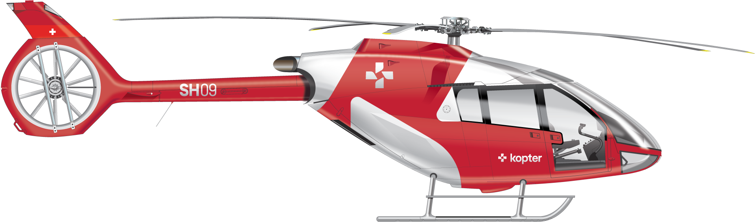
@ Kopter Group AG | Alejandro Valverde

Slide 23
Thank you

Slide 24
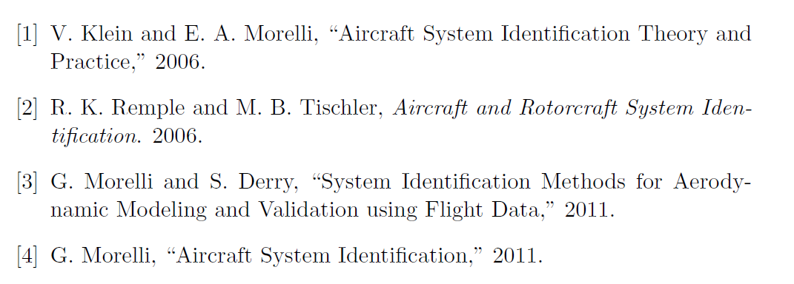
References
@ Kopter Group AG | Alejandro Valverde

Slide 25
System ID methodology diagram
Manoeuvre
Actual Response (training dataset)
Measurements
Optimized Input
Input
Helicopter
Data Collection & Compatibility
Methods
Parameter Estimation
A Priori Values, lower/upper bounds
Estimation Algorithm / Optimization
Identification Criteria
+
-
Response Error
Parameter Adjustments
Models
Mathematical Model / Simulation
Model Response
Model structure
Identification Phase
Complementary Flight Data (validation dataset)
Model Validation
Validation Phase
@ Kopter Group AG | Alejandro Valverde

Slide 26
FCS design
Optimization of Flightlab parameters to match flight data
Simulation development
Evaluation of SID possibilities for SH09
Integration of SID routine with Flightlab
Development of the SID framework suitable for flight test data
Flightlab linearized model
Flightlab nonlinear model
P3 flight test data

